Slide 1

Making Presentations That Stick
A STEP TOWARDS INNOVATION
A guide by Chip Heath & Dan Heath

Slide 2

1.INDUSTRIALIST AND ENTERPRENEURS FACE PROBLEMS IN INDENTIFYING VACANT LAND FOR INDUSTRIAL USE.
2. THEY DO NOT HAVE ANY PLATEFORM TO KNOW THE STATUS OF VACANT LAND AND KNOW THE BEST SUITABLE LAND.
PROBLEM STATEMENT OF ORISSA SMALL SCALE INDUSTRY

Slide 3
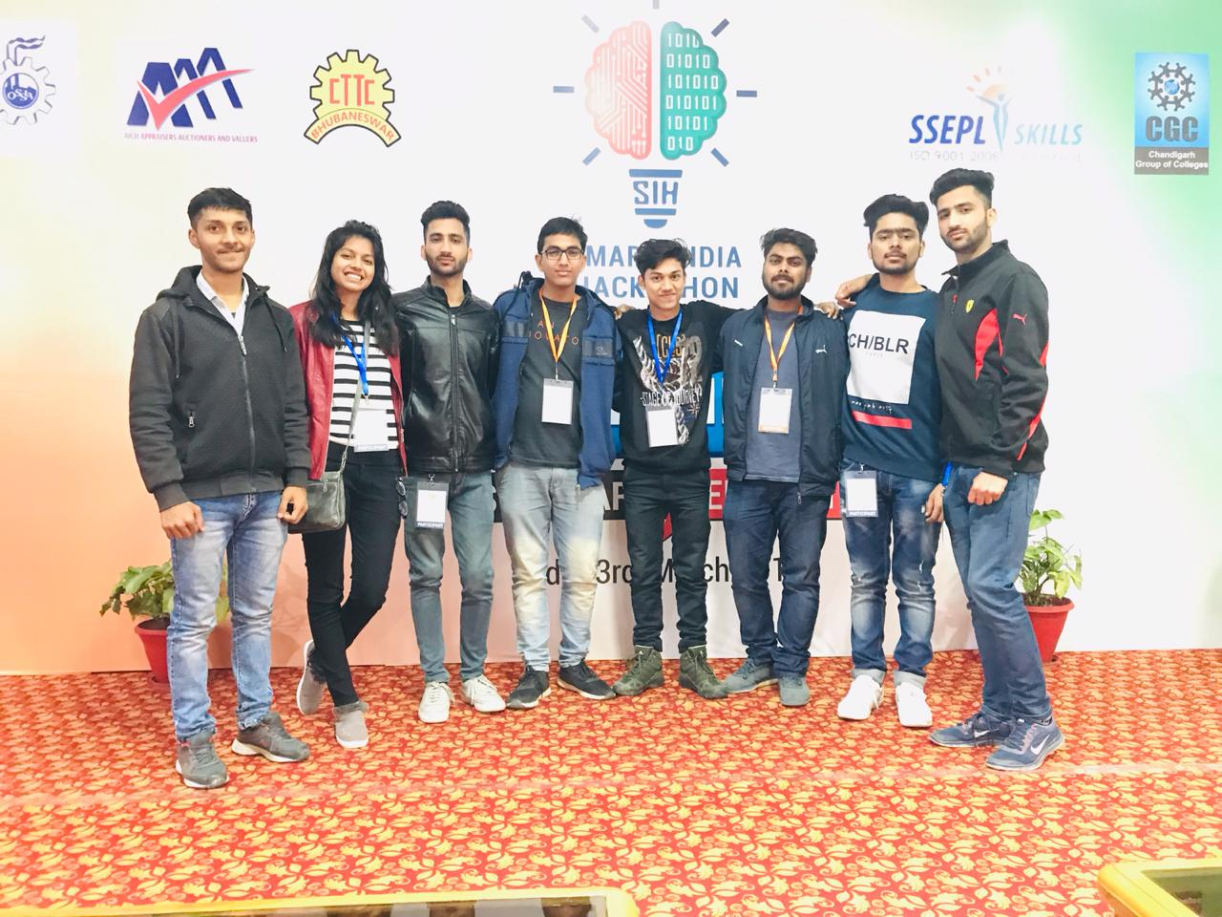
TEAM SQUADY SIX PRESENTS THE SOLUTION
The application intends to provide a user friendly interface to effectively manage land resources in the nation for industrial use and to make it easily available for the interested entrepreneurs.

Slide 4
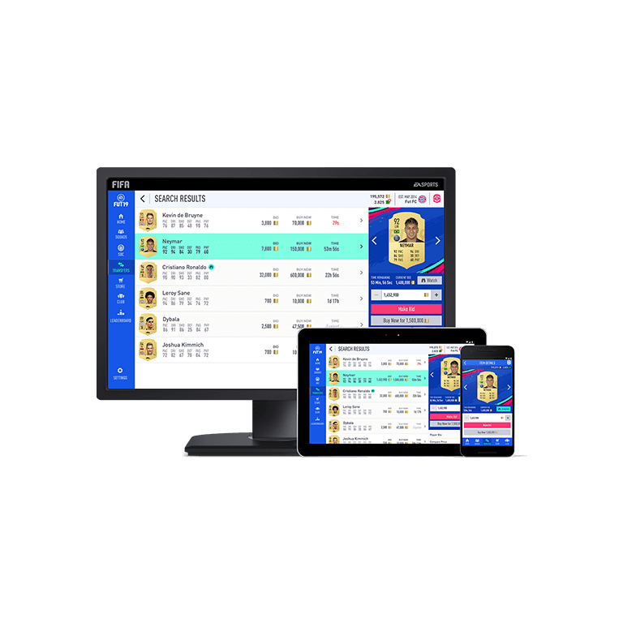
PERIHERALS PROVIDED BY
OUR APP:
CROSS PLATEFORM APP:
-WEB APP
-ANDROID App Future enhancement -IOS APP

Slide 5
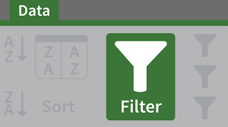
2. THIS PLATEFORM ENABLE INDUSTRIALIST TO FILTER AND SORT LANDS TO FIND THE MOST PREFERABLE LAND.

Slide 6
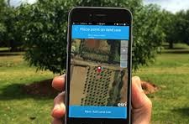
3. IMAGES
RESULTS ARE PRESENTED ALONG WITH IMAGES OF THE ACTUAL LAND.

Slide 7


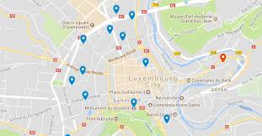
4. GOOGLE MAPS
GOOGLE MAPS ARE INTEGRATED WITHIN THE APP.
IT ENABLES THE MAP VIEW OF LOCATION WITH GPS FOR A BETTER UNDERSTANDING AND VISIBILITY

Slide 8

5.BOOKMARKS
Users can bookmark the preferred lands and can request for the private display of the same.
He loved soccer, but feared he had no way to talk to a coach or teammates.

Slide 9

6. AUCTIONS
A key feature enables the users to participate in the government organised and managed auctions.
.
Visitors to his store, mostly tourists, speak many different languages making anything beyond a simple transaction a challenge.
Story for illustration purposes only

Slide 10

7.QUERIES
The platform can also be extended to avail the feature of providing feedback and raising queries.

Slide 11
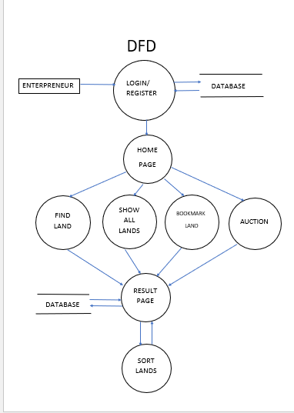
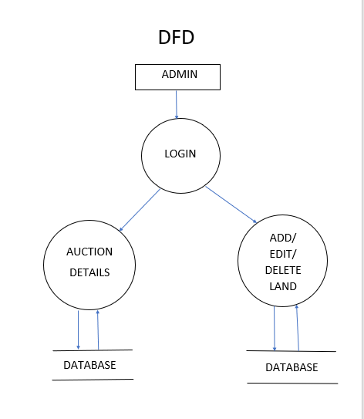
D
F
D

Slide 12
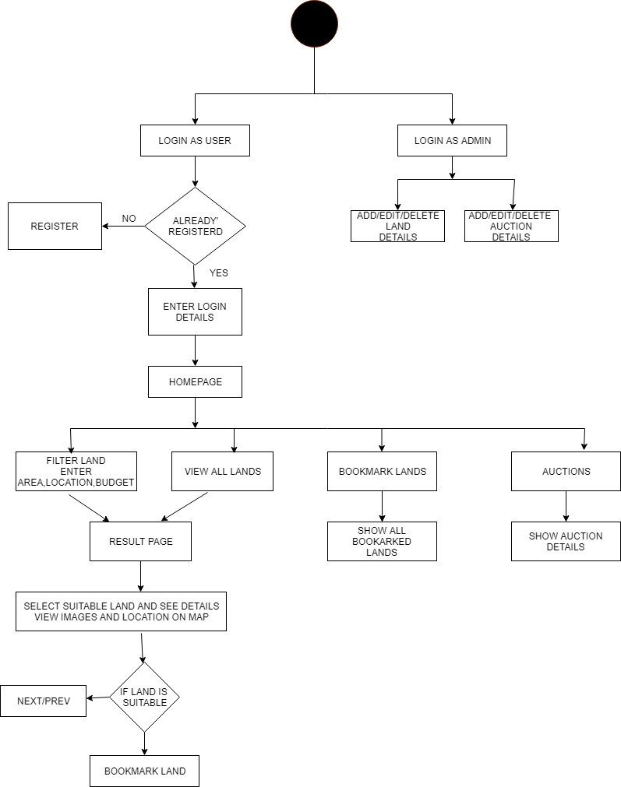
UML DIAGRAM

Slide 13
OVER TO THE WORKING…..

